Slide 1



Procedure to solve
Circuit
A presentation on methods and procedures to solve a series or a parallel electrical circuit.

Slide 2

Introduction of Series Circuit

Slide 3

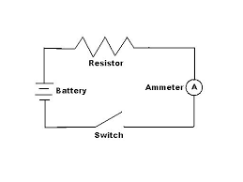
What is circuit?
A circuit is a closed loop that electrons can travel in. A source of electricity such as a battery provides electrical energy in the circuit.

Slide 4
Types of Circuit
Series circuit
Parallel circuit

Slide 5
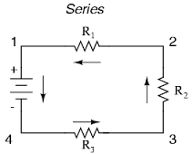
Series circuit
The components are connected end- to- end, one after another. They make a simple loop for the current to flow round. The total resistance R,
R=R1 +R2+R3

Slide 6
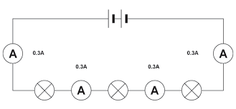
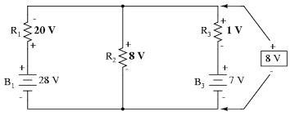
Series circuit
Current is the same at all points in the circuit
Voltage is shared between the components

Slide 7
Series circuit
One path(s) for current
Adding resistance in series decreases total current
Decreased current means dimmer light
Break in circuit stops all current

Slide 8
Structure of Series Circuit

Slide 9
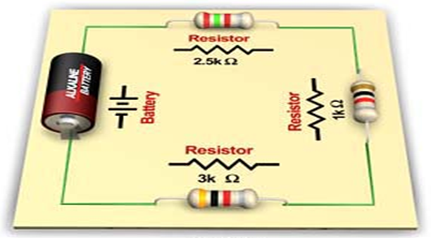
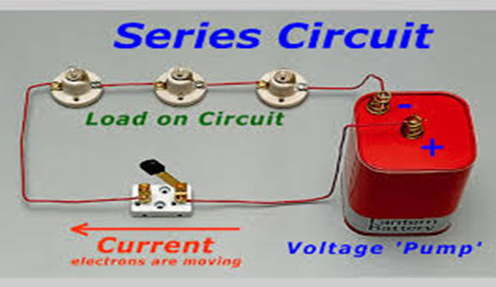
Component of a circuit
A circuit needs three thing:
1. Energy Source
2.Path(wire)
3.Load( light & resistance etc.) 4. key / switch

Slide 10
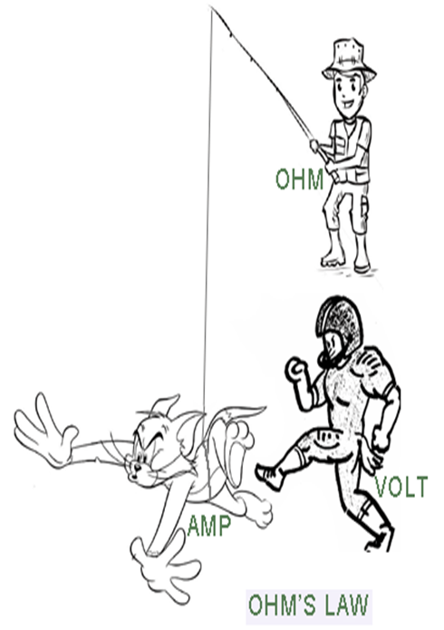
How to work circuit by Ohm’s Law
Most problems involve three characteristics of a circuit:
i) resistance R,
ii) voltage V and
iii) current I
Ohm's Law tells that they are related in a simple way:
V = IR.
I = V / R
R = V/I

Slide 11
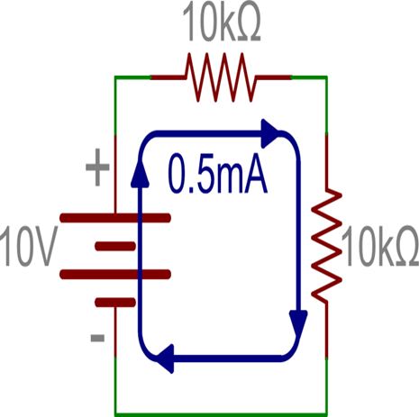
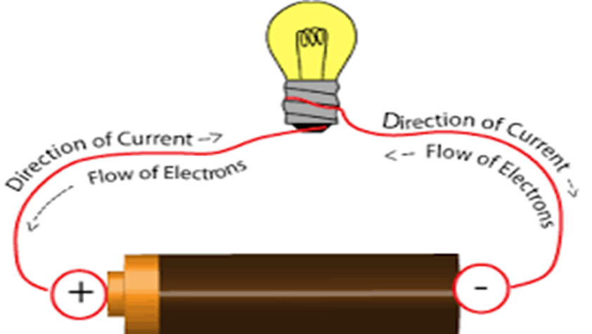
How to work current in series circuit
In a series circuit :
i. only one path for current flow,
ii. following same current at all points on the circuit

Slide 12
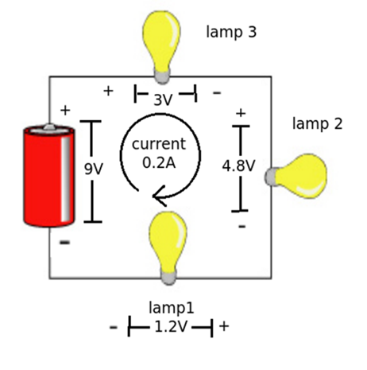
Character of voltage in series circuit
Dropping the voltage across each component of the series circuit add up to the total voltage drop across the circuit like:
v1 + v2 + v3 = Vt (total voltage)
It is Called kirchhoff’s voltage law ( KVL)

Slide 13
Solving a Series Circuit

Slide 14
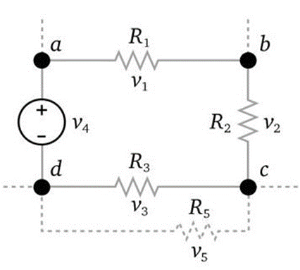
Solving a Series Circuit
Kirchhoff’s Voltage law(KVL): The algebraic sum of all voltages around a closed loop must be equal to zero. Σ voltage drops - Σ voltage rises = 0 or, Σ voltage drops = Σ voltage rises
The sum of all the voltages around the loop is equal to zero : v1+v2+v3-v4=0.

Slide 15
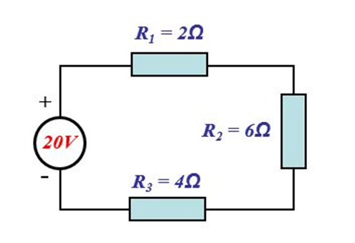
Solving a Series Circuit
RTotal = 12Ω.
According to ohm’s law: V=IR.
So, Is = 1.67A
vD = V1+V2+V3
= IsR1+IsR2+IsR3
= 20.04V
So, here voltage drops and voltage rises are same. The sum of all the voltages around the loop is equal to zero.

Slide 16
Introduction of Parallel Circuit

Slide 17
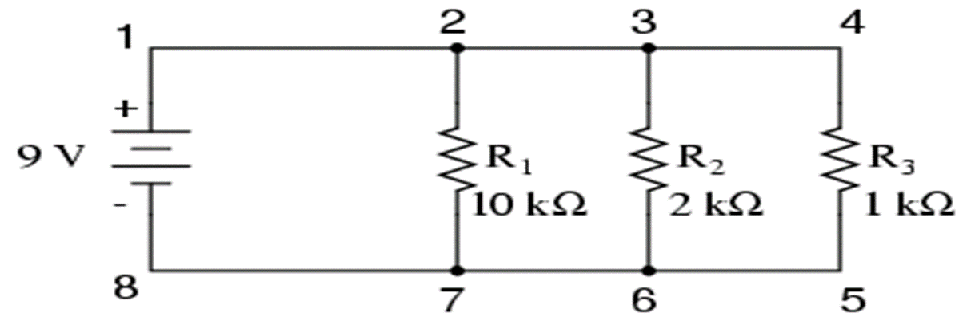
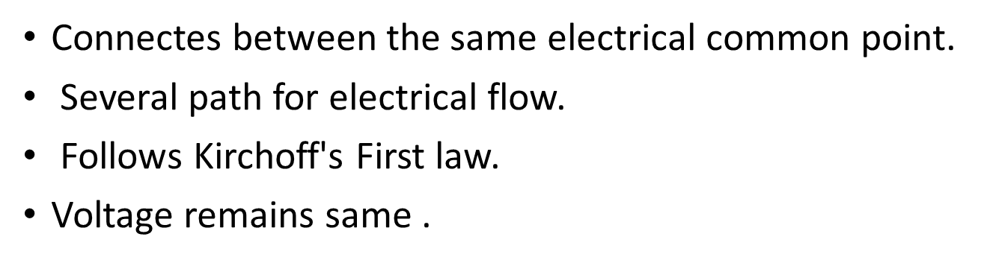
Parallel Circuit

Slide 18
Advantages & Usage of parallel circuit
Equipments gets same power.
Individual switching system.
Easy replacement.
Used in household wiring.
Shunt is connected in parallel circuit.

